Slide 1
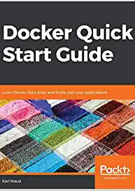
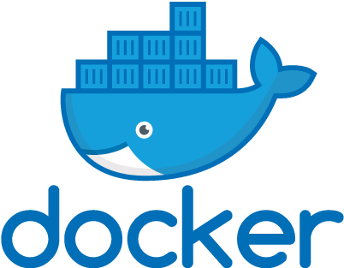
Docker Quick Start Guide
Working through the book, chapter by chapter
Earl Waud

Slide 2
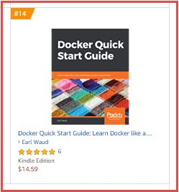
reasons you might want to use this book to learn Docker
Docker Quick Start Guide reached #14 on the Top 100 Paid best sellers list in the System Administration category.
It currently has a 4.2 out of 5.0 star rating on Amazon.com
It has been my best selling book, selling about 2000 print and kindle copies worldwide so far
And… You can SSO into Oreilly and click the following link for access to the full book FOR FREE: https://learning.oreilly.com/library/view/docker-quick-start/9781789347326/toc.xhtml

Slide 3
Today…
Chapter 1: Setting up a Docker Development Environment
Chapter 2: Learning Docker Commands
Chapter 3: Creating Docker Images
Chapter 4: Docker Volumes
Chapter 5: Docker Swarm
Chapter 6: Docker Networking
Chapter 7: Docker Stacks
Chapter 8: Docker and Jenkins

Slide 4
What we will cover today
What is Docker swarm?
Setting up a Docker swarm cluster
Managers and workers
Swarm services
Accessing container applications in a swarm

Slide 5

Fun Fact
There are currently over 17,000,000 shipping containers in the world, and 5 or 6,000,000 of them are currently shipping around the world on vessels, trucks, and trains. In total, they make around 200,000,000 trips a year.
https://www.billiebox.co.uk/facts-about-shipping-containers

Slide 6
Technical requirements
You will be pulling Docker images from Docker's public repo, so basic internet access is required to execute the examples within this chapter. You will be setting up a multi-node swarm cluster, so you will need multiple nodes to complete the examples in this chapter. You can use physical servers, EC2 instances, Virtual Machines on vSphere or Workstation or even on Virtual Box. I utilized 6 VMs on VMware Workstation for my nodes. Each VM is configured with 2 GB ram, 1 CPU, and 20 GB HDD. The guest OS utilized is Xubuntu 20.04 for its small size and full Ubuntu feature set. Xubuntu can be downloaded from https://xubuntu.org/download/. Virtually any modern Linux operating system choice would be acceptable for the nodes.
The code files of this chapter in the book can be found on GitHub:
https://github.com/PacktPublishing/Docker-Quick-Start-Guide/tree/master/Chapter05
Check out the following video to see the code in action: http://bit.ly/2KENJOD

Slide 7
What is Docker Swarm
You probably have not noticed this, but so far, all of the Docker workstation deployments, or nodes that we have used in our examples have been run in single-engine mode.
Docker swarm is a way to link Docker nodes together, and manage those nodes and the dockerized applications that run on them efficiently and at scale.
Simply stated, a Docker swarm is a group of Docker nodes connected and managed as a cluster or swarm.
Docker swarm is built into the Docker engine, so no additional installation is required to use it. When a Docker node is part of a swarm, it is running in swarm mode.
If there is any doubt, you can easily check whether a system running Docker is part of a swarm or is running in single-engine mode using the docker system info command

Slide 8
docker system info command
docker system info
docker system info | grep Swarm

Slide 9
When a node joins a swarm
Once a Docker node joins a swarm, it becomes a swarm node, becoming either a Manager node or a Worker node.
We will talk about the difference between managers and workers shortly.
For now, know that the very first Docker node to join a new swarm becomes the first Manager, also known as the Leader.
There is a lot of technical magic that happens when that first node joins a swarm (actually, it creates and initializes the swarm, and then joins it) and becomes the leader.

Slide 10
What happens when a node joins a swarm?
A Swarm-ETCD-based configuration database or cluster store is created and encrypted
Mutual TLS (mTLS) authentication and encryption is set up for all inter-node communication
Container orchestration is enabled, which takes responsibility for managing which containers run on which nodes
The cluster store is configured to automatically replicate to all manager nodes
The node gets assigned a cryptographic ID
A Raft-based distributed consensus-management system is enabled
The node becomes a Manager and is elected to the status of swarm leader
The swarm managers are configured for HA
A public-key infrastructure system is created
The node becomes the certificate authority, allowing it to issue client certificates to any nodes that join the swarm
A default 90-day certificate-rotation policy is configured on the certificate authority
The node gets issued its client certificate, which includes its name, ID, the swarm ID, and the node's role in the swarm
Creating a new cryptographic join token for adding new swarm managers occurs
Creating a new cryptographic join token for adding new swarm workers occurs

Slide 11
How to set up a swarm cluster
docker swarm init
With that single swarm init command, the swarm cluster is created, the node is transformed from a single-instance node into a swarm-mode node, the role of manager is assigned to the node and it is elected as the leader of the swarm, the cluster store is created, the node becomes the certificate authority of the cluster and assigns itself a new certificate that includes a cryptographic ID, a new cryptographic join token is created for managers, and another is created for workers, and on and on.
This is complexity made simple.

Slide 12
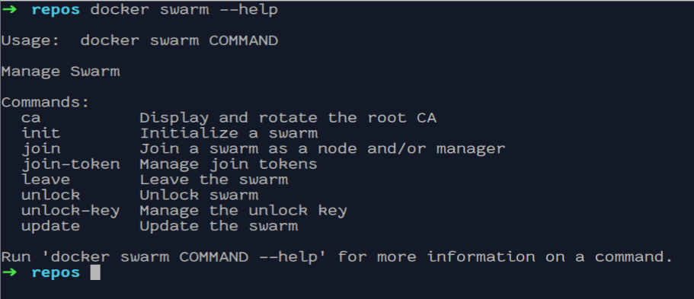
The Docker swarm management group

Slide 13
Required protocols and ports
The following ports must be available, some may be open by default:
TCP port 2377 for cluster management communications
TCP and UDP port 7946 for communication among nodes
UDP port 4789 for overlay network traffic
TCP port 2375 for Docker REST API (plain text)
TCP port 2376 for Docker REST API (ssl)
If using overlay networking with encryption ( --opt encrypted ), you also need to ensure IP protocol 50 (ESP) traffic is allowed
ESP = encapsulating security payload.

Slide 14
docker swarm init
You have already seen what the init command is for, that being to create the swarm cluster, add the first Docker node to it, and then set up and enable all of the swarm features we just covered.
The init command can be as simple as using it with no parameters, but there are many optional parameters available to fine-tune the initialization process.
You can get a full list of the optional parameters, as usual, by using --help, but let's consider a few of the available parameters now:
--autolock: Use this parameter to enable manager autolocking.
--cert-expiry duration: Use this parameter to change the default validity period (of 90 days) for node certificates.
--external-ca external-ca: Use this parameter to specify one or more certificate-signing endpoints, that is, external CAs.

Slide 15
Autolock and RAFT
Docker has the ability to protect the mutual TLS encryption key and the key used to encrypt and decrypt Raft logs at rest, by allowing you to take ownership of these keys and to require manual unlocking of your managers. This feature is called autolock.
Raft is a consensus algorithm.
Consensus is a fundamental problem in fault-tolerant distributed systems. Consensus involves multiple servers agreeing on values. Once they reach a decision on a value, that decision is final.
Want to know more: https://foxutech.com/what-is-raft-and-how-its-working-on-docker-swarm/

Slide 16
docker swarm join-token
When you initialize the swarm by running the swarm init command on the first node, one of the functions that is executed creates unique cryptographic join tokens, one joins additional manager nodes, and one joins worker nodes.
Using the join-token command, you can obtain these two join tokens.
In fact, using the join-token command will deliver the full join command for whichever role you specify.
The role parameter is required.
Here are examples of the command:
# Get the join token for adding managers
docker swarm join-token manager
# Get the join token for adding workers
docker swarm join-token worker

Slide 17
docker swarm join
You have already seen the join command used in the preceding docker swarm join-token section. The join command is used, in conjunction with a cryptographic join token, to add a Docker node to the swarm.
All nodes except the very first node will use the join command to become part of the swarm (the first node uses the "init" command, of course).
The join command has a few parameters, the most important of them being the --token parameter.
This is the required join token, obtainable with the join-token command. Here is an example:
# Join this node to an existing swarm
docker swarm join --token
SWMTKN-1-3ovu7fbnqfqlw66csvvfw5xgljl26mdv0dudcdssjdcltk2sena830tv7e8bajxu1k5dc0045zn
192.168.159.156:2377

Slide 18
docker swarm ca
The swarm ca command is used when you want to view the current certificate for the swarm, or you need to rotate the current swarm certificate.
To rotate the certificate, you would include the --rotate parameter:
# View the current swarm certificate
docker swarm ca
# Rotate the swarm certificate
docker swarm ca --rotate
The swarm ca command can only be executed successfully on a swarm manager node

Slide 19
docker swarm unlock
You may recall from the discussion regarding the docker swarm init command that one of the optional parameters that you can include with the init command is --autolock.
Using this parameter will enable the autolock feature on the swarm cluster. What does that mean?
Well, when a swarm cluster is configured to use auto-locking, any time the docker daemon of a manager node goes offline, and then comes back online (that is, is restarted) it is necessary to enter an unlock key to allow the node to rejoin the swarm.

Slide 20
docker swarm unlock-key
The swarm unlock-key command is much like the swarm ca command.
The unlock-key command can be used to retrieve the current swarm unlock key, or it can be used to rotate the unlock key to a new one:
# Retrieve the current unlock key
docker swarm unlock-key
# Rotate to a new unlock key
docker swarm unlock-key --rotate
Depending on the size of the swarm cluster, the unlock key rotation can take a while for all
of the manager nodes to get updated.

Slide 21
TIP: hang on to you keys (for a bit)
It is a good idea to keep the current (old) key handy for a while when you rotate the unlock key, on the off-chance that a manager node goes offline before getting the updated key. That way, you can still unlock the node using the old key.
Once the node is unlocked and receives the rotated (new) unlock key, the old key can be discarded.

Slide 22
docker swarm update
There are several swarm cluster features that are enabled or configured when you initialize the cluster on the first manager node via the docker swarm init command.
There may be times that you want to change which features are enabled, disabled, or configured after the cluster has been initialized. To accomplish this, you will need to use the swarm update command. For example, you may want to enable the auto-lock feature for your swarm cluster. Or, you might want to change the length of time that certificates are valid for. These are the types of changes you can execute using the swarm update command. Doing so might look like this:
# Enable autolock on your swarm cluster
docker swarm update --autolock=true
# Adjust certificate expiry to 30 days
docker swarm update --cert-expiry 720h

Slide 23
docker swarm leave
This one is pretty much what you would expect. You can remove a docker node from a swarm with the leave command

Slide 24
Swarm Managers and workers
We have discussed swarm managers a little in the previous sections, but let's take a closer look at what swarm managers do.
The swarm managers do exactly what you would expect. They manage and maintain the state of the swarm cluster. They schedule swarm services, which we will talk about shortly, but for now, think of swarm services as running containers.
Manager nodes also serve up the API endpoints of the cluster, allowing for programmatic access via REST. Managers also direct traffic to the running services so that any container can be reached through any manager node without having to know which node is actually running the containers. As part of maintaining the state of the cluster, the managers will deal with the loss of nodes in the system, electing a new leader node in the event that the manager lost was the leader, and they will keep the desired number of service containers running if containers or nodes go down.

Slide 25
How many managers do you need?
The best practices for the number of manager in a swarm are three, five, or seven.
You'll note that all of these options represent an odd number of manager nodes. This is so that if the leader node is lost, the raft consensus algorithm can more easily select a new leader for the swarm.
You can run a swarm cluster with one manager node, and that is actually a better option than having two manager nodes.
But, for a much more highly available swarm cluster, it is recommended that you have at least three manager nodes.
For larger clusters, having five or seven managers is good, but it is not recommended to have more than seven. Once you have more than seven managers in the same cluster, you actually experience degraded performance.

Slide 26
Tip: Keep your managers close
Another important consideration for the manager nodes is the network performance between them. Managers need a low-latency network connection for optimal performance.
If you are running your swarm in AWS, for example, you probably don't want the managers within a swarm spread across regions.
You would likely encounter issues with the swarm if you were to do so.
If you put the managers within a swarm in different availability zones within a single region, you shouldn't have any network-performance-related issues.

Slide 27
Worker nodes
Worker nodes don't do anything except run containers.
They don't have a say in electing new leaders when the leader node goes down. They don't handle API calls.
They don't direct traffic.
They do nothing but run containers.
In fact, you can't have a swarm with just a worker node.
On the other hand, you can have a swarm with just a manager node, in which case the manager will also act as a worker and run containers in addition to its manager duties.
All manager nodes are actually worker nodes as well by default.

Slide 28
Changing the role of a node
There may be times when you want or need to change the role of a docker node in the swarm.
You can promote a worker node to manager status, or you can demote a manager node to worker status. Here are some examples of these activities:
# Promote worker nodes 04 and 05 to manager status
docker node promote ubuntu-node04 ubuntu-node05
# Demote manager nodes 01 and 02 to worker status
docker node demote ubuntu-node01 ubuntu-node02

Slide 29
Swarm services
Now you know about setting up a Docker swarm cluster, and how its nodes go from single-engine mode into swarm mode.
You also know that the significance of that is to free you from directly managing individual running containers. So, you may be starting to wonder, if I don't manage my containers directly and individually now, how do I manage them?
This is where swarm services come into play. swarm services allow you to define the desired state for your container application in terms of how many concurrent running copies of the container there should be.

Slide 30
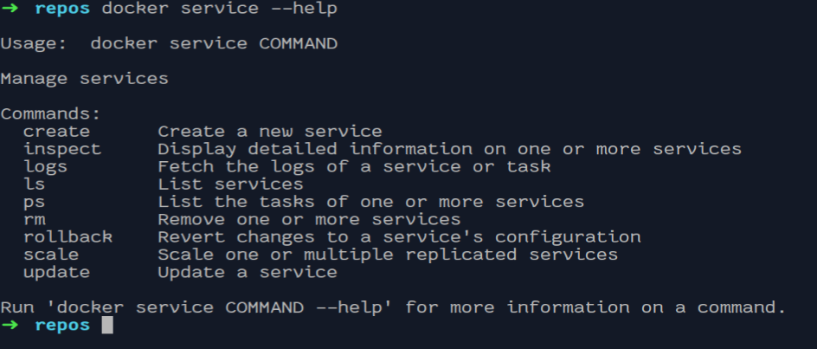
Services management group

Slide 31
Service create
The first thing that you'll probably want to do is create a new service, so we will begin our swarm services discussion with the service create command. Here is the syntax and a basic sample of the service create command:
# Syntax for the service create command
# Usage: docker service create [OPTIONS] IMAGE [COMMAND] [ARG...]
# Create a service
docker service create --replicas 1 --name submarine alpine ping google.com
docker service ls
docker service ps submarine

Slide 32
Service create command unpacked
docker service create --replicas 1 --name submarine alpine ping google.com
Let's break it down. First, you have the management group service followed by the create command.
Then, we start getting into the parameters; the first one is --replicas. This defines the number of copies of the container that should be run concurrently.
Next, we have the --name parameter. This one is the name of the service we are creating, in this case, submarine. We will be able to use the stated name in other service commands.
After the name parameter, we have the fully-qualified Docker image name. In this case, it is just alpine.
Following the image name to use for the service is the command to use when running the container and the parameters to pass to that command — ping and google.com, respectively.
So, the preceding sample service create command will launch a single container from the alpine image, which will run the ping command with the google.com parameter, and then name the service submarine.

Slide 33
Is that all there is to services?
You now know the basics of creating docker services. But, before you get too excited, there's still a lot of ground to cover for the service create command. In fact, this command has so many options that listing them all out would take about 4 or 5 slides.
So, rather than do that, I want you to use the --help feature and enter the following command now:
# Get help with the service create command
docker service create --help

Slide 34
Another service example
Let's try out another example, this time one that uses the --publish parameter.
We'll give the nginx image another run:
# Create a nginx web-server service using the publish parameter
docker service create --name web-service --replicas 3 --publish published=8080,target=80 nginx
# Or the abbreviated format
docker service create --name web-service --replicas 3 --publish 8080:80 nginx

Slide 35
Accessing container applications in a swarm
So, now you have a swarm running with an odd number of manager nodes, and a number of worker nodes. You have deployed some swarm services to run your favorite containerized applications. What's next?
Well, you just might want to access one or more of the applications running in your swarm. Perhaps you have deployed a web server application. It would be nice to be able to visit the web pages shared by that web server, right?
Let's take a quick look and see how easy it is to do so.

Slide 36
Service ps command
One of the features that the swarm managers handle for us is to direct traffic to our services. In an earlier example, we set up a web service that was running three replicas in the swarm.
The swarm I am currently using happens to have three manager nodes and three worker nodes.
All six nodes are eligible to run workloads so when the service is started, three of the six nodes will end up running a container.
If we take a look at the details of the tasks of the service using the service ps command, you can see which of the six nodes are running the web-service containers:
# List the containers running as part of the web-service service
docker service ps web-service

Slide 37
Summary
Today, we finally started to pull some of the pieces together and make some fun stuff happen.
We learned how much functionality we get by enabling swarm mode, and creating a swarm cluster. And, we found out just how easy it is to set everything up, using one single swarm init command.
Then, we learned how to grow and manage our swarm cluster, and finally, we learned how to run our containers as services within our new swarm cluster.
It's been fun, right?!

Slide 38


